Slide 1
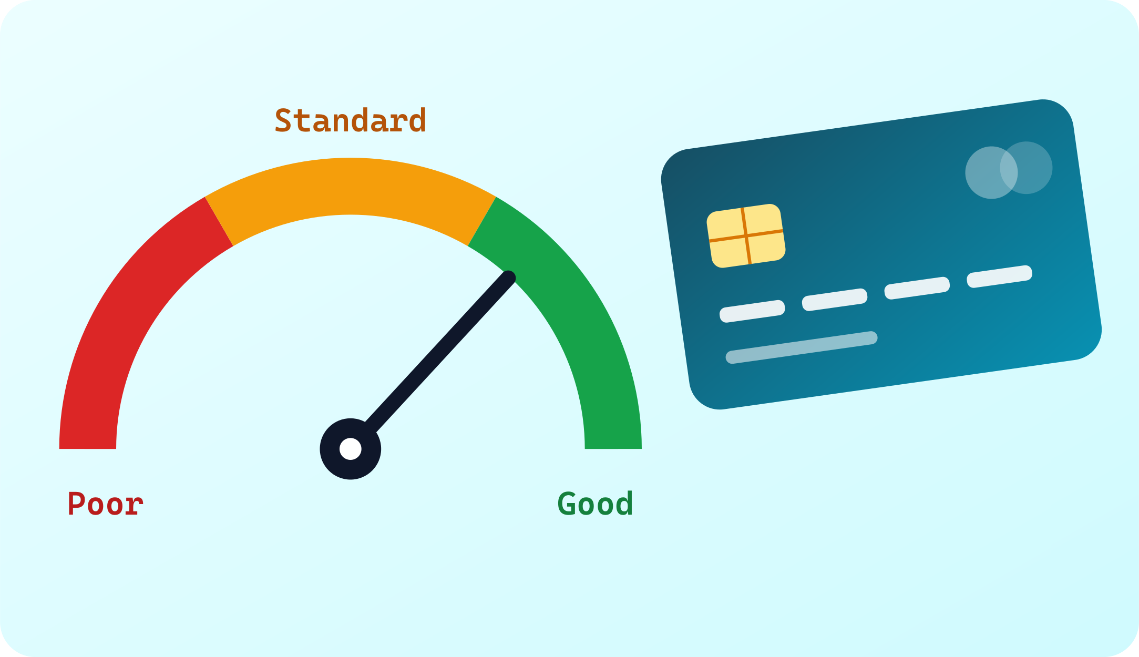
Credit Score Classification
Exploratory Data Analysis and an interactive Streamlit dashboard
Marcellino Ashraf · Data Science Diploma — Mid Project
Notes:
Introduce the project: an exploratory analysis of a real-world, messy credit dataset, the cleaning it needed, six analysis questions, and a Streamlit dashboard that presents the results.

Slide 2



Credit scoring decides who gets credit
THE FIELD
What it is
Why it matters
Where data helps
Banks rate each customer's creditworthiness — how likely they are to repay what they borrow.
The score drives loan approvals, credit limits and the interest rate a customer is offered.
Income, debt and payment history can explain — and later predict — a customer's score.
Three score levels in this data: Poor · Standard · Good
Notes:
Credit scoring is how banks summarise a customer's risk. The score affects approvals, limits and interest. This dataset labels each customer-month as Poor, Standard or Good.

Slide 3
A year of banking data for 12,500 customers
THE DATA
100,000
Customer: Age, Occupation, Annual Income, Monthly In-hand Salary
rows in train.csv (one per customer per month)
Accounts & loans: Bank Accounts, Credit Cards, Number & Type of Loans, Interest Rate
28
Payment behaviour: Delay from Due Date, Delayed Payments, Paid Only Minimum, Payment Behaviour
columns: personal, financial, credit behaviour, target
Debt & balance: Outstanding Debt, Credit Utilization, Monthly EMI, Investments, Balance
8
Credit profile: Credit Mix, Credit History Age, Credit Inquiries, Credit Limit Change
months tracked per customer (January – August)
Target: Credit_Score — Poor / Standard / Good
Source: Kaggle — “Credit Score Classification” (parisrohan)
Notes:
The dataset comes from Kaggle. Each customer appears once per month for eight months. Columns cover the customer, their accounts and loans, payment behaviour, debt and their credit profile, plus the target: the credit score.

Slide 4
What each column represents
COLUMN DICTIONARY · 1 OF 2
Column | What it represents | Example value
ID | Unique identifier of each record (row) | 0x1602
Customer_ID | Unique identifier of the customer | CUS_0xd40
Month | Month of the record (January to August) | January
Name | Name of the customer | Aaron Maashoh
Age | Age of the customer | 23
SSN | Social Security Number of the customer | 821-00-0265
Occupation | Occupation of the customer | Scientist
Annual_Income | Annual income of the customer | 19114.12
Monthly_Inhand_Salary | Monthly take-home salary of the customer | 1824.84
Num_Bank_Accounts | Number of bank accounts the customer holds | 3
Num_Credit_Card | Number of credit cards the customer holds | 4
Interest_Rate | Interest rate on the customer's credit card (%) | 3
Num_of_Loan | Number of loans taken from the bank | 4
Type_of_Loan | Types of loans the customer has taken | Auto Loan, Credit-Builder Loan, and Personal Loan
Notes:
The 28 original columns as they come in train.csv, before any cleaning: identifiers, personal details and the first financial columns.

Slide 5
What each column represents (continued)
COLUMN DICTIONARY · 2 OF 2
Column | What it represents | Example value
Delay_from_due_date | Average number of days a payment is late after the due date | 3
Num_of_Delayed_Payment | Number of payments the customer delayed | 7
Changed_Credit_Limit | Percentage change in the credit card limit | 11.27
Num_Credit_Inquiries | Number of credit card inquiries | 4
Credit_Mix | Classification of the customer's mix of credits (Good, Standard, Bad) | Good
Outstanding_Debt | Remaining debt still to be paid | 809.98
Credit_Utilization_Ratio | Ratio of credit used to total available credit (%) | 26.82
Credit_History_Age | Age of the customer's credit history | 22 Years and 1 Months
Payment_of_Min_Amount | Whether the customer paid only the minimum amount due (Yes, No, NM = Not Mentioned) | No
Total_EMI_per_month | Total monthly EMI (Equated Monthly Instalment) payments | 49.57
Amount_invested_monthly | Amount the customer invests each month | 80.42
Payment_Behaviour | The customer's spending level combined with their payment size | High_spent_Small_value_payments
Monthly_Balance | The customer's monthly balance | 312.49
Credit_Score | Target: the credit score bracket (Poor, Standard, Good) | Good
Notes:
The remaining columns: payment behaviour, debt, credit profile and the target, Credit_Score.

Slide 6


Built for machine learning, so it comes in two files
TWO FILES
train.csv
test.csv
Rows: 100,000
Months: January – August
Credit_Score: included (the answer)
Rows: 50,000
Months: September – December
Credit_Score: missing (to be predicted)
Used for this analysis
Kept for a future ML phase
Why only train.csv? Every question in this EDA is about how the credit score relates to other columns. test.csv describes the same 12,500 customers for the next four months but has no credit score, so it cannot answer those questions.
Notes:
Kaggle published this data for a classification task, so it is split into train and test. Both cover the same customers; test continues their history but without the score. For an exploratory analysis of the score we need the labelled file, so only train.csv is used. test.csv stays in the repo for a later machine-learning phase.

Slide 7
Six questions about what drives the score
PURPOSE
Goal: clean a messy real-world dataset, then find which customer characteristics separate Poor from Good credit scores.
Does the occupation of a customer affect the credit score?
Do customers with higher income get better credit scores?
Q1
Q2
How does late payment behaviour relate to the credit score?
How do outstanding debt and interest rate differ between score groups?
Q3
Q4
Does having more credit cards, bank accounts or loans worsen the score?
Do a longer credit history and a better credit mix mean a better score?
Q5
Q6
Notes:
These six questions structure the analysis. Q1 focuses on occupation; the others look at income, payment behaviour, debt, number of credit products, and credit history and mix.

Slide 8




The raw data was far from clean
DATA QUALITY
Numbers stored as text
Impossible values
Age “28_”, income “34847.84_”, loans “0_”: trailing underscores made 8 numeric columns text.
Age −500 and 8,698 · 1,499 credit cards · interest rate 5,797% · −100 loans.
Placeholders & garbage
Missing values
“__10000__” invested, balance “−3.3e+26”, behaviour “!@9#%8”, occupation “_______”.
Up to 15% missing (Monthly In-hand Salary), plus Type of Loan 11%, Credit History Age 9%.
Notes:
This slide proves the dataset was not clean: numbers stored as text with underscores, physically impossible values, placeholder and garbage strings, and missing values of up to fifteen percent in some columns.

Slide 9
Fix each value using the same customer's history
CLEANING
1
2
3
4
Fix types
Mark bad values
Fill per customer
Drop or engineer
Strip “_”, convert text to numbers
Placeholders and impossible values → missing
Use that customer's own mode / median
Drop 4.3% bad loan rows · history text → months
Why per customer? Each customer appears 8 times, and values like income, age and occupation rarely change month to month — so a customer's own months are the most reliable source for a missing or broken value.
95,652
0
clean rows (from 100,000)
missing values · 0 duplicates
Reusable functions: impute_by_customer() and fix_customer_spikes() — no copy-pasted cleaning code
Notes:
The cleaning followed four steps. The key idea is to repair each value from the same customer's other months, because a customer's income, age and job stay stable. Two reusable functions handle impossible values and sudden spikes. The result: 95,652 rows, no missing values and no duplicates, saved as cleaned_data.parquet.

Slide 10
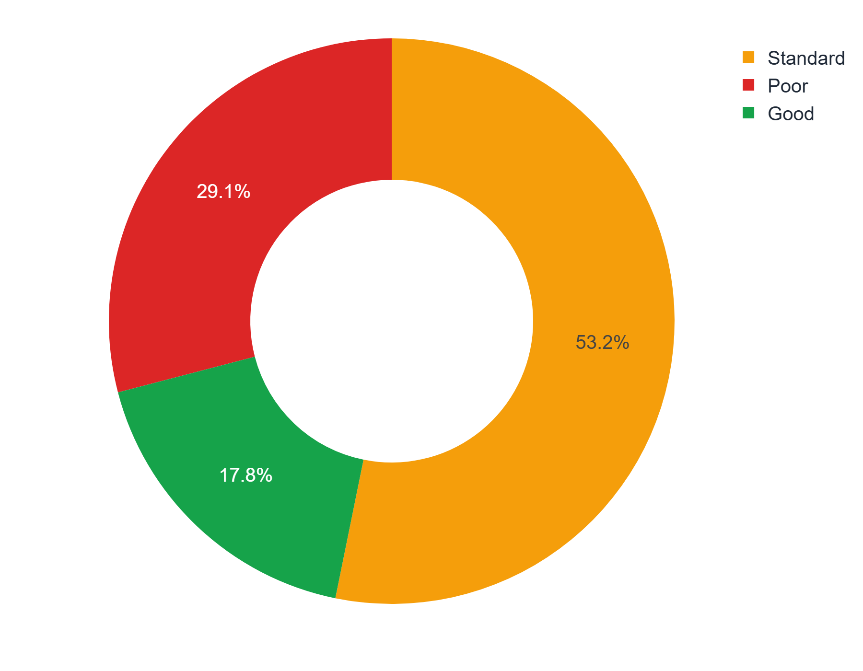
Most customers sit in the middle
UNIVARIATE ANALYSIS
53.2%
Standard — the majority
29.1%
17.8%
Poor
Good — the rarest group
The target is imbalanced: a future model would need to handle the small Good class carefully.
Notebook chart: px.pie of Credit_Score
Notes:
The target variable: over half the records are Standard, 29% Poor and only 18% Good. This imbalance matters if we later build a classifier.

Slide 11
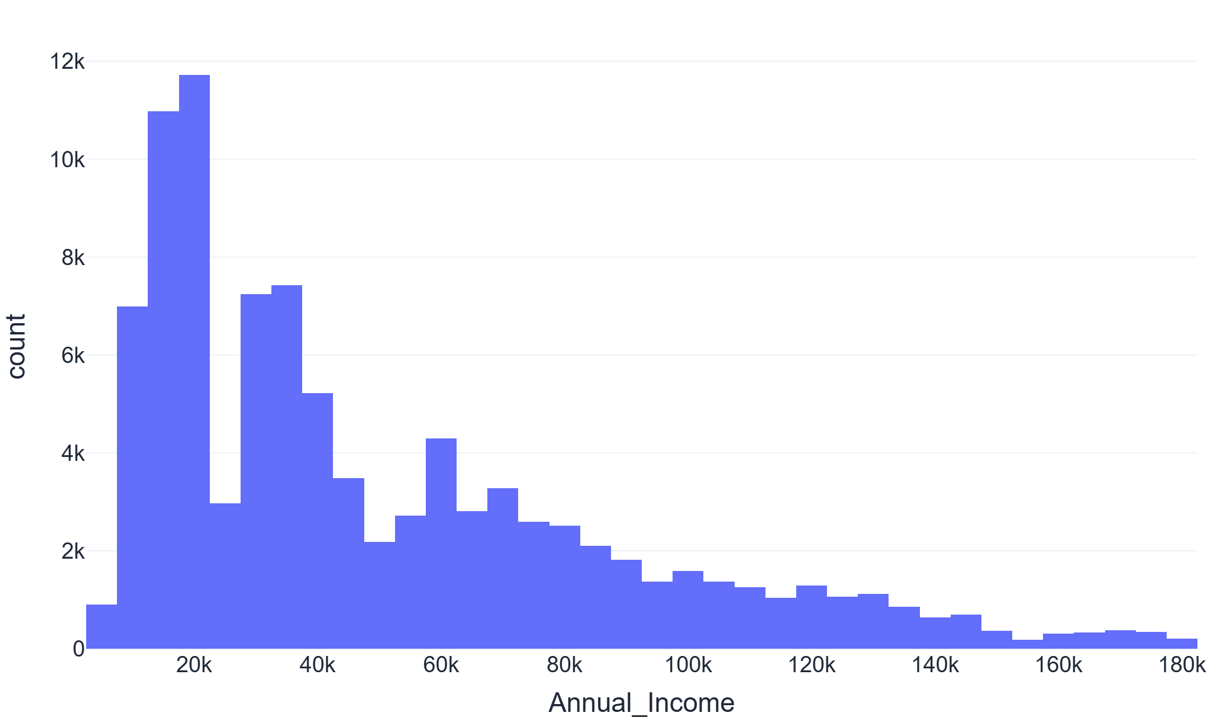
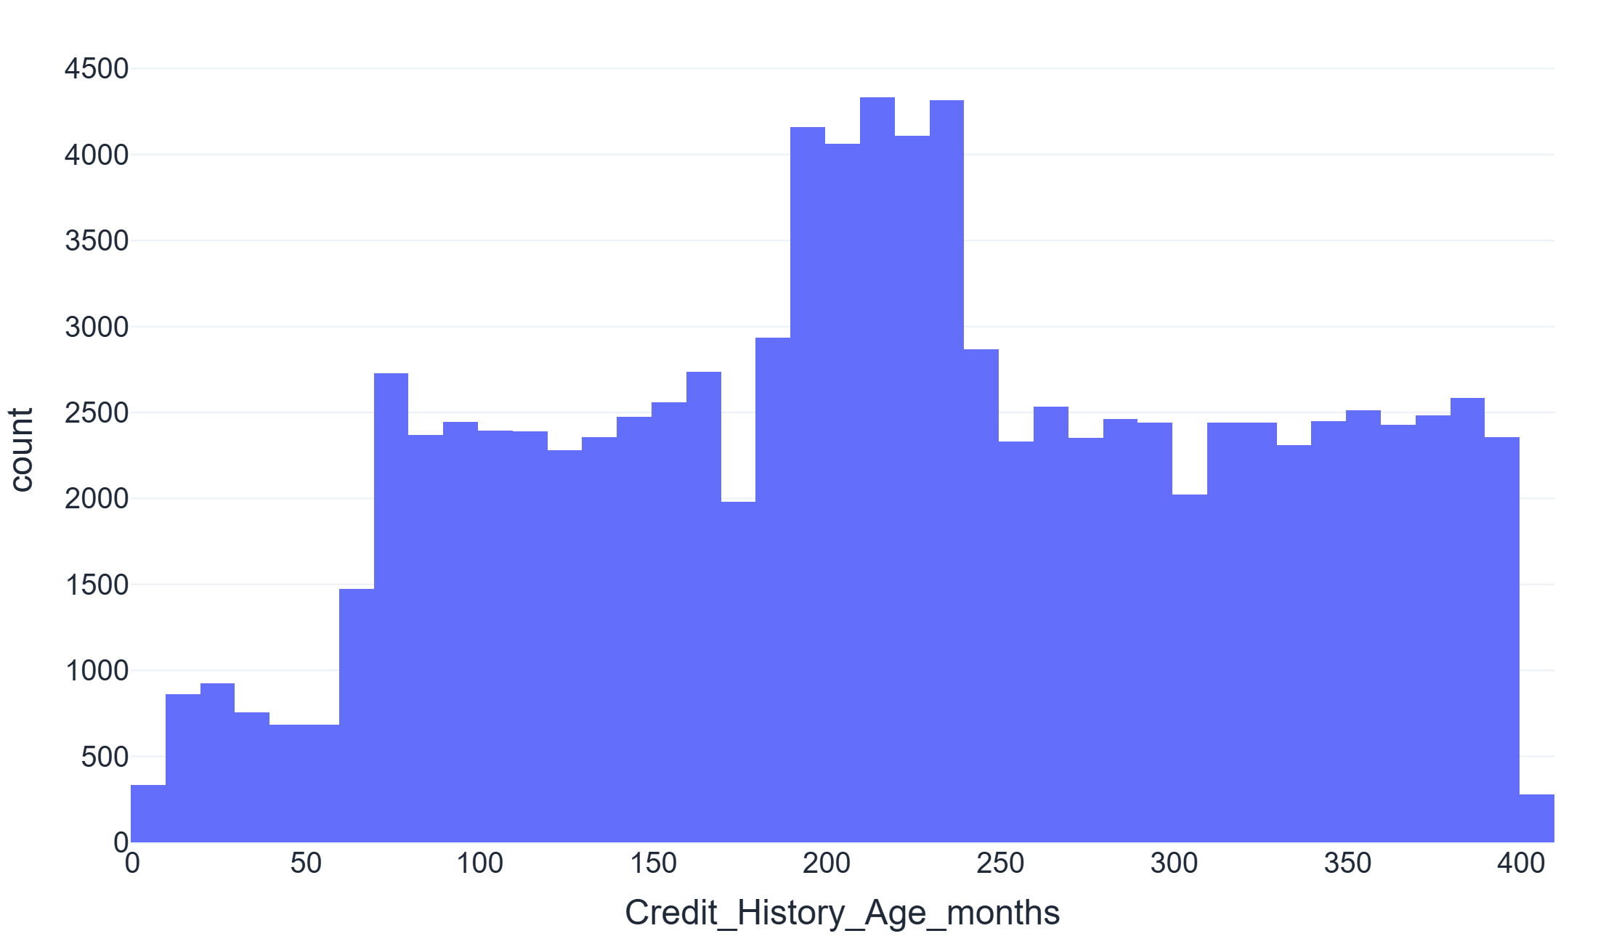
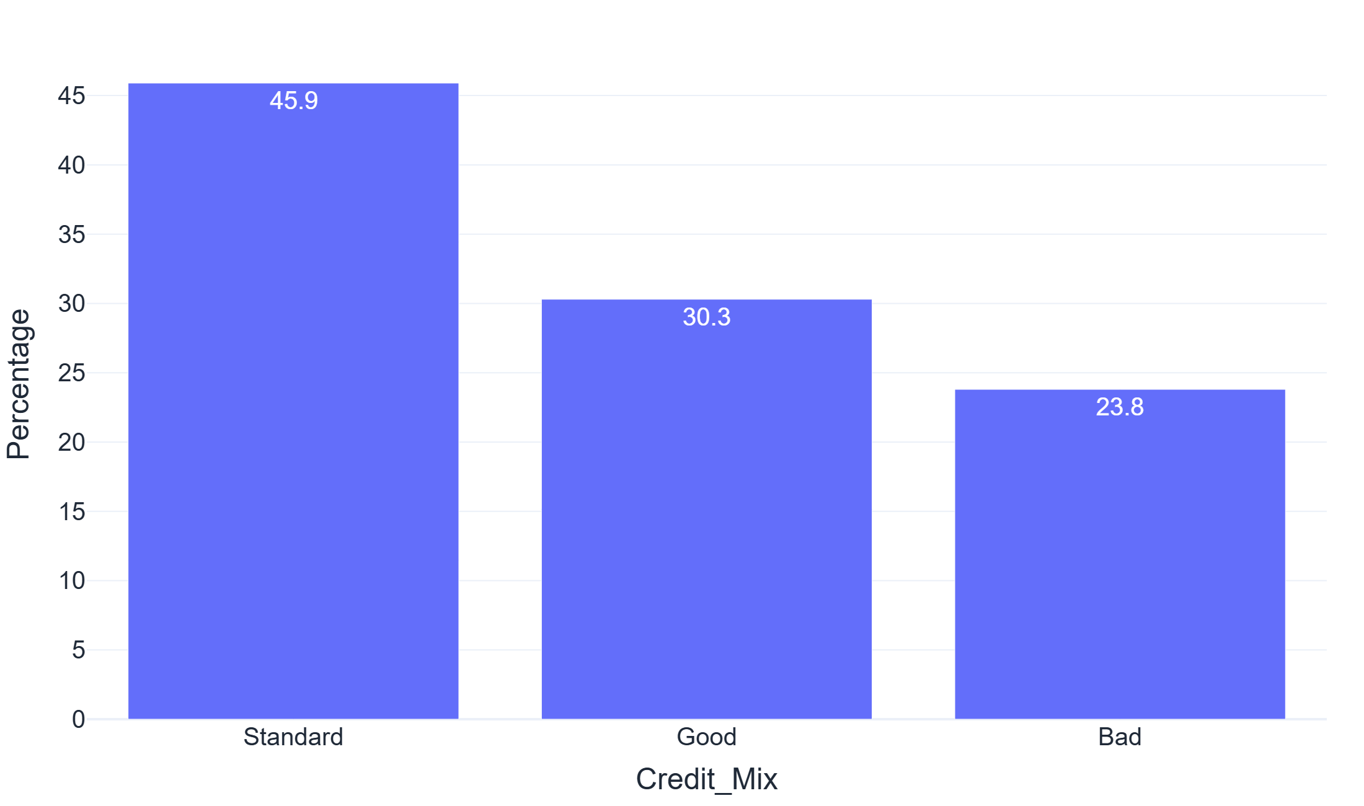
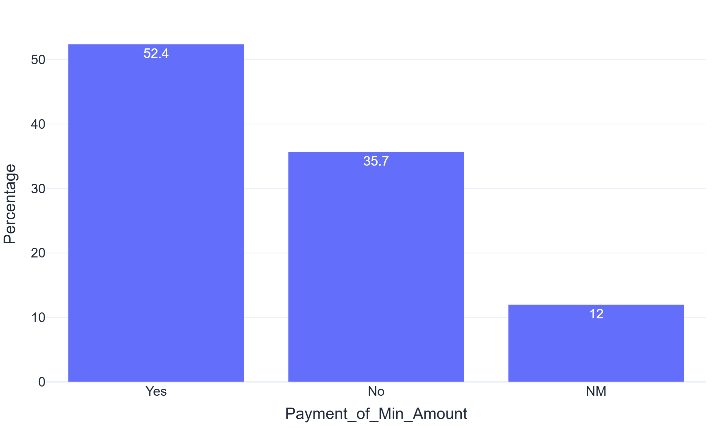
Income is skewed; credit habits vary widely
UNIVARIATE ANALYSIS
Annual income — right-skewed: most earn little, a few earn a lot
Credit history age (months) — spread evenly from new to 33 years
Credit mix — Standard is the most common
Paid only the minimum — the majority do
Notes:
Histograms with box plots for numeric columns and bar charts for categorical ones. Income and debt are right-skewed, credit history is spread widely, most customers have a Standard credit mix and over half pay only the minimum amount.

Slide 12
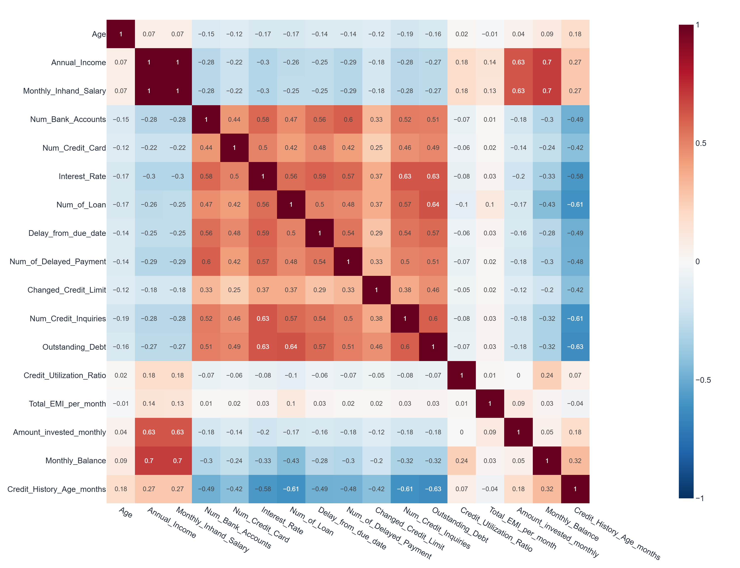
Risk signals move together
BIVARIATE ANALYSIS
Same information: Annual income and monthly salary correlate at 1.0.
Risk cluster: loans, interest rate, delays, inquiries and debt all rise together (0.5–0.64).
Opposite direction: credit history age falls as debt (−0.63) and loans (−0.61) rise.
No link: credit utilization is almost unrelated to everything else.
Notes:
The correlation heatmap shows a cluster of risk signals that move together, and that customers with longer credit histories have less debt and fewer loans.

Slide 13
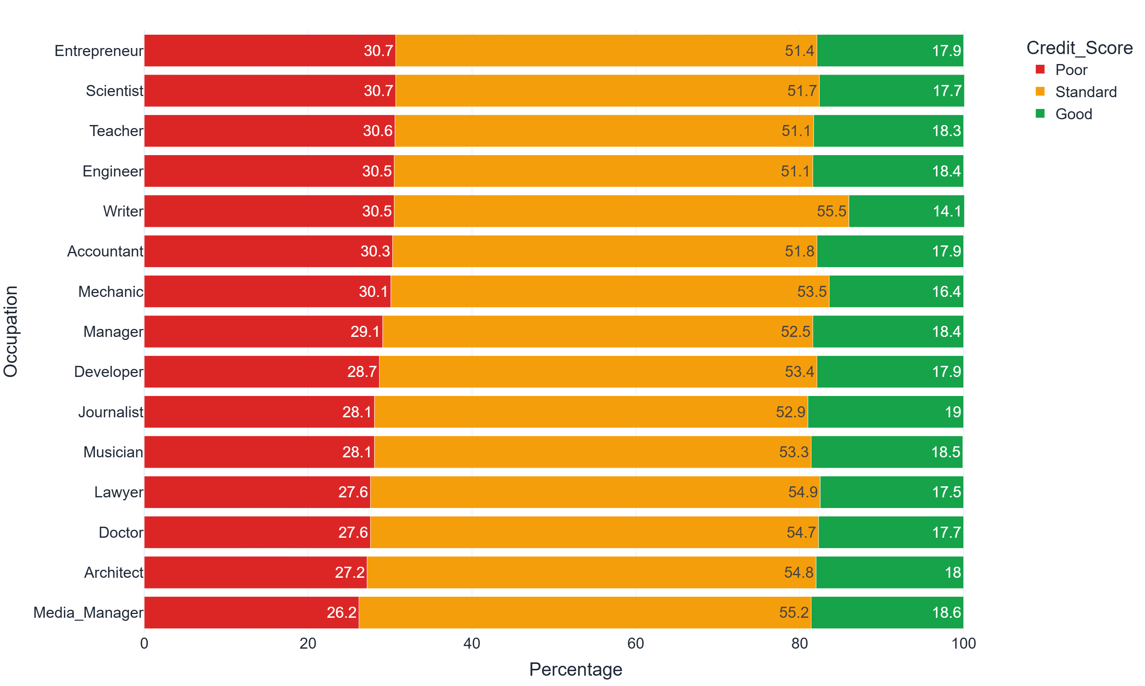
Occupation barely changes the credit score
QUESTION 1 · DOES THE OCCUPATION OF A CUSTOMER AFFECT THE CREDIT SCORE?
26.2%
lowest Poor share (Media Manager)
30.7%
highest Poor share (Entrepreneur, Scientist)
Answer: only a 4.5-point gap. Median income is also similar for every job (≈ $35K–$39K). Occupation is a very weak signal.
Credit score mix per occupation, sorted by % Poor
Notes:
Question one, about occupation: every job has between 26 and 31 percent Poor scores, so the job itself says very little. Writers have the fewest Good scores at 14 percent. Income is also similar across jobs.

Slide 14
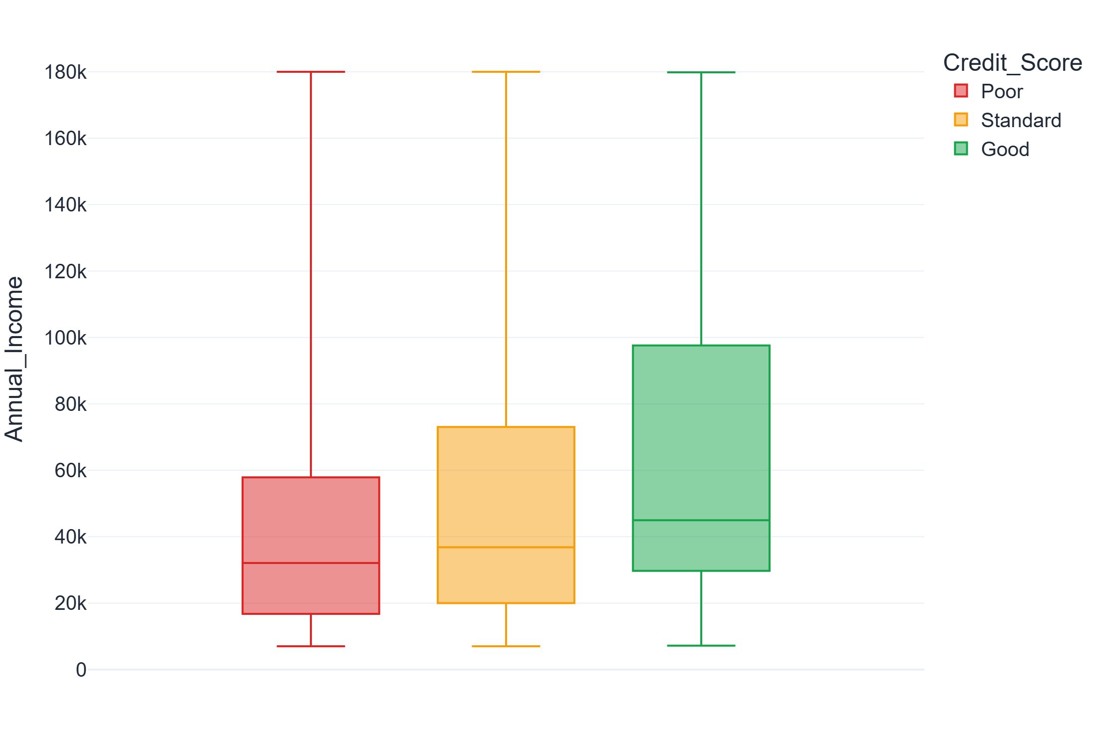
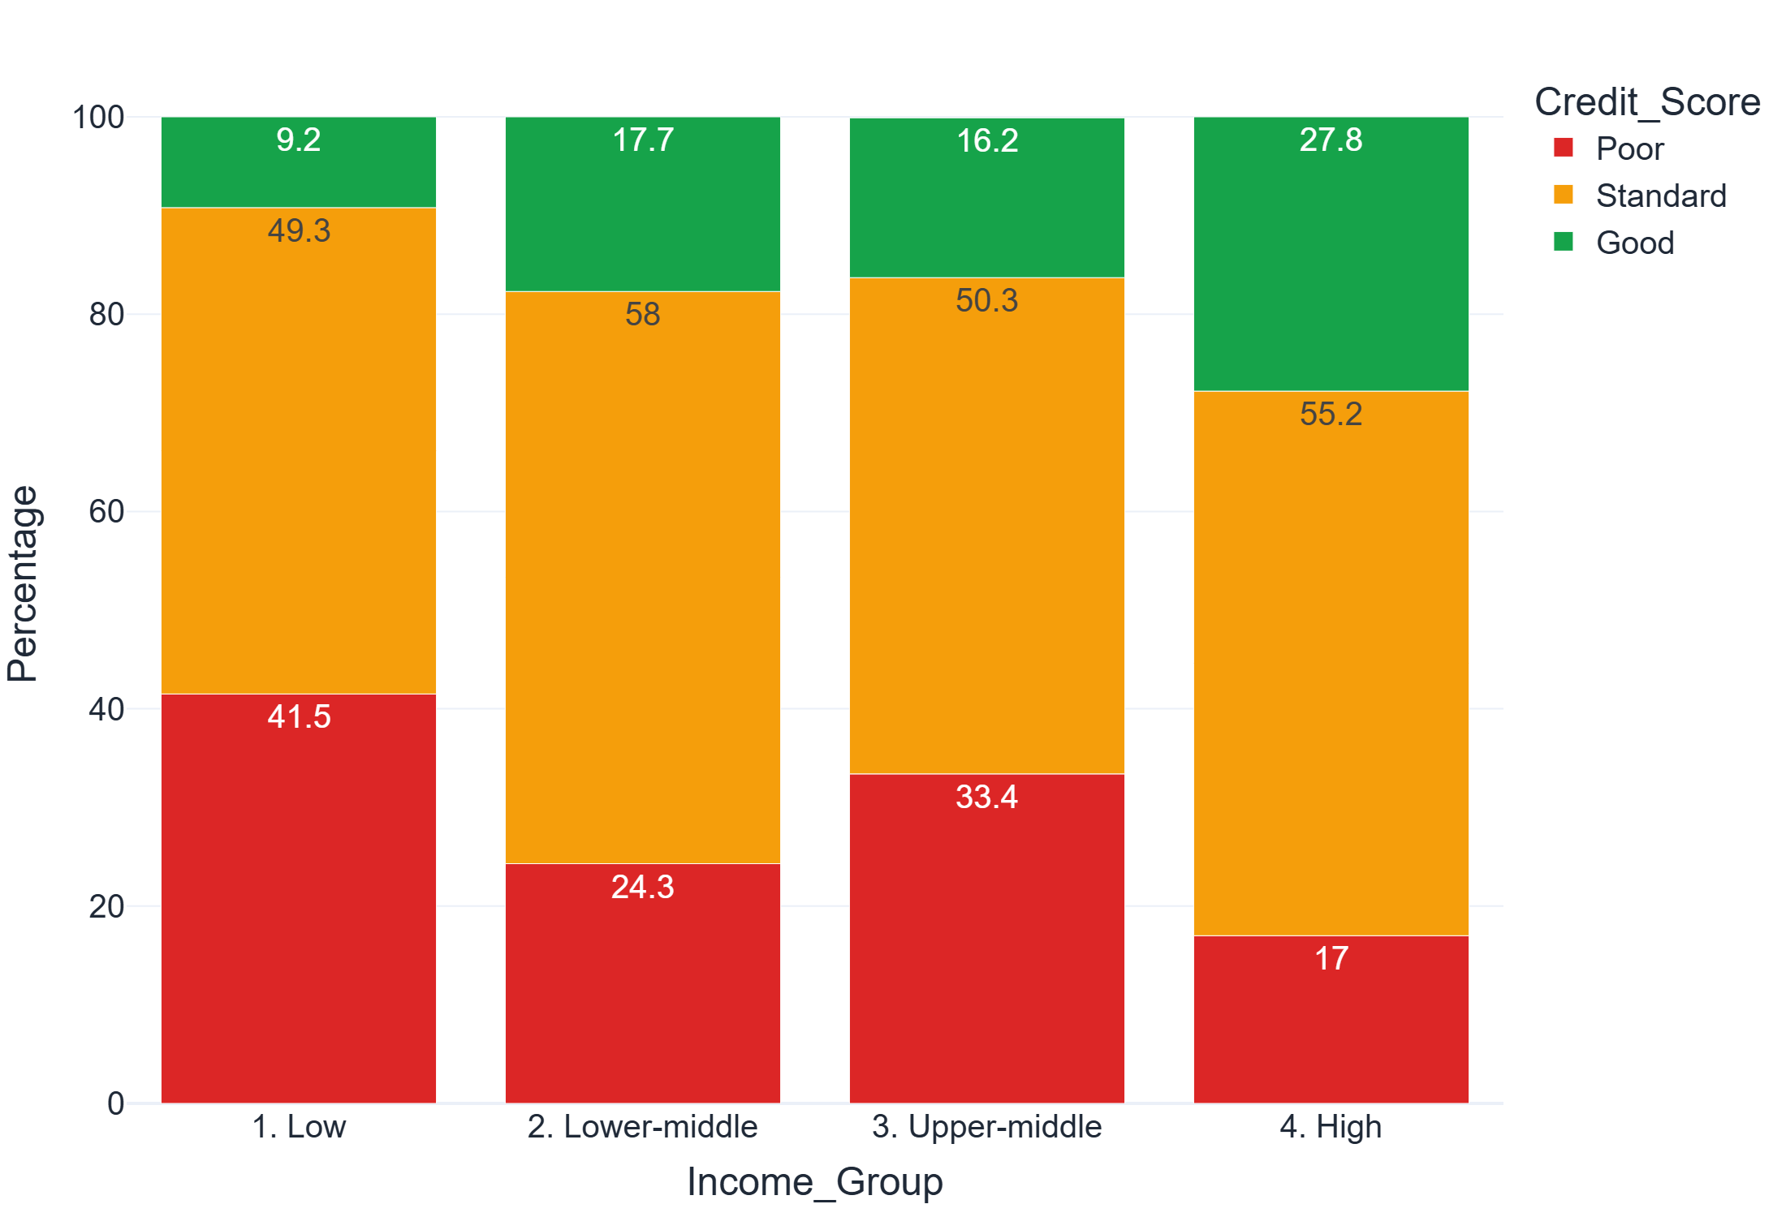
Higher income helps, but does not decide it
QUESTION 2 · DO CUSTOMERS WITH HIGHER INCOME GET BETTER CREDIT SCORES?
Answer
Median income: $32K Poor · $37K Standard · $45K Good.
Lowest income quarter: 41.5% Poor, 9.2% Good — highest quarter: 17.0% Poor, 27.8% Good (but not a smooth trend).
Notes:
Good customers earn more — around 45 thousand versus 32 thousand for Poor. Splitting customers into income quarters shows the lowest group is much more likely to be Poor, but the trend isn't perfectly smooth, so income alone doesn't decide the score.

Slide 15
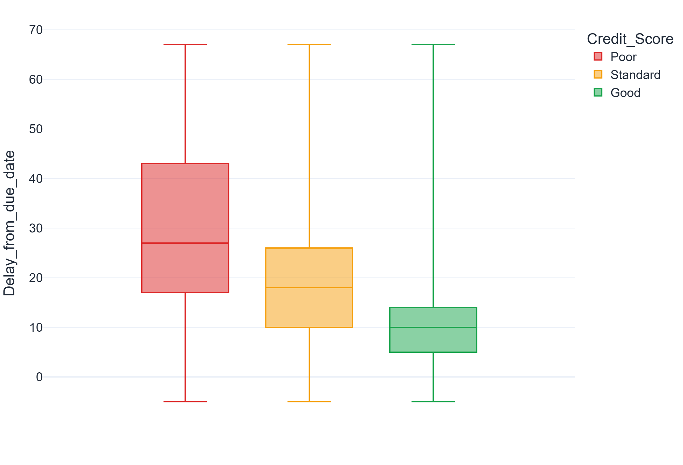
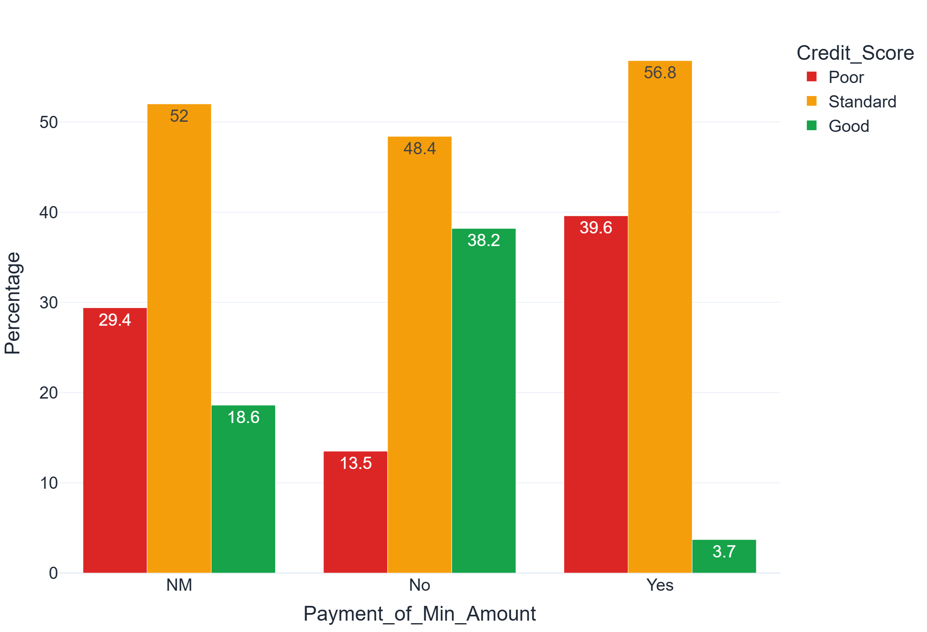
Paying late or only the minimum signals Poor
QUESTION 3 · HOW DOES LATE PAYMENT BEHAVIOUR RELATE TO THE CREDIT SCORE?
Answer
Median days late: 27 for Poor vs 10 for Good; delayed payments 17 vs 8.
Paying only the minimum: 39.6% Poor and just 3.7% Good — paying more: 38.2% Good.
Notes:
Payment behaviour is one of the clearest signals. Poor customers pay a median of 27 days late compared with 10 for Good. Those who pay only the minimum are almost never Good.

Slide 16
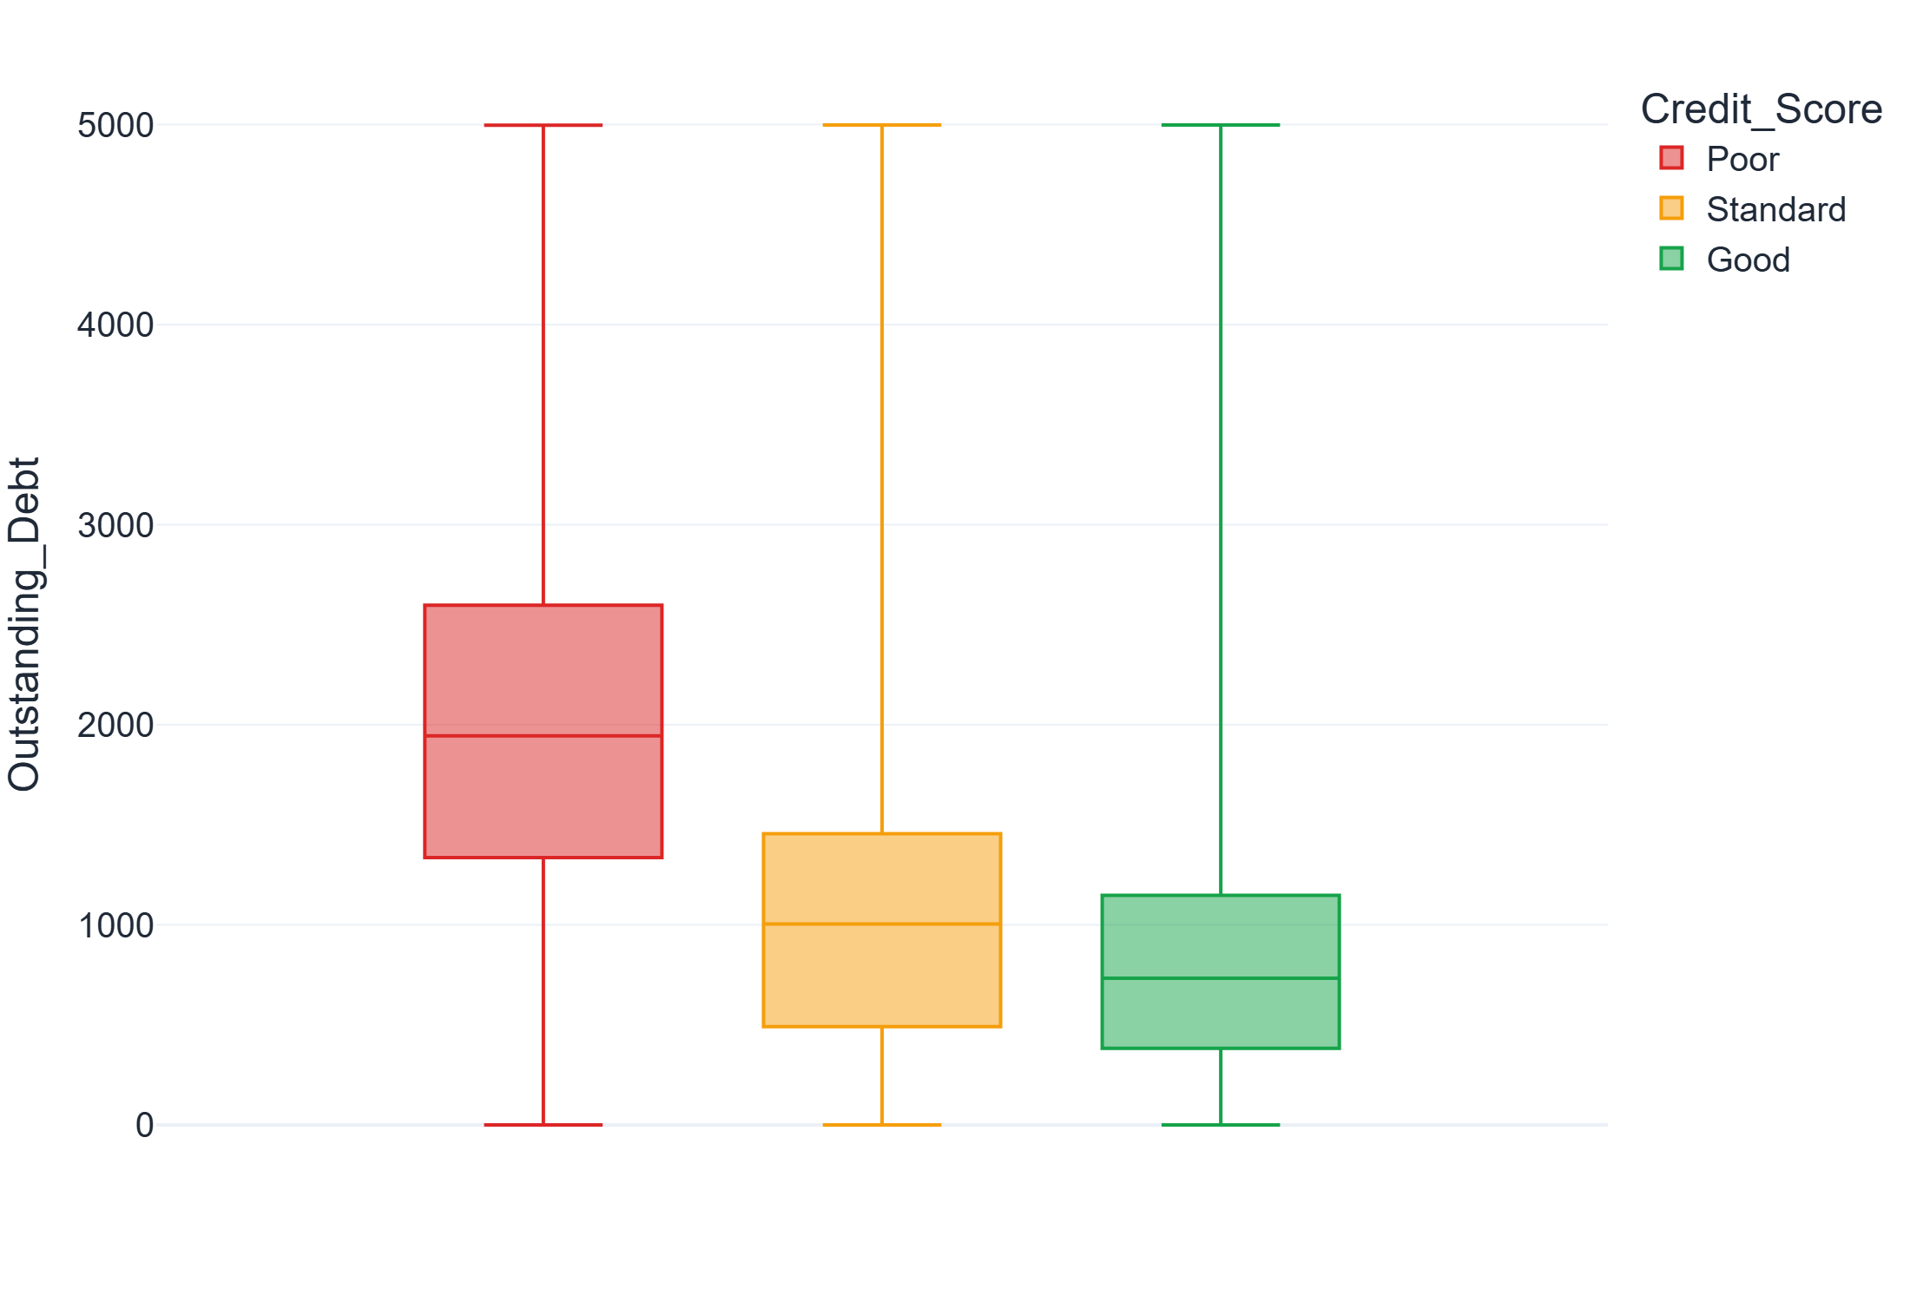
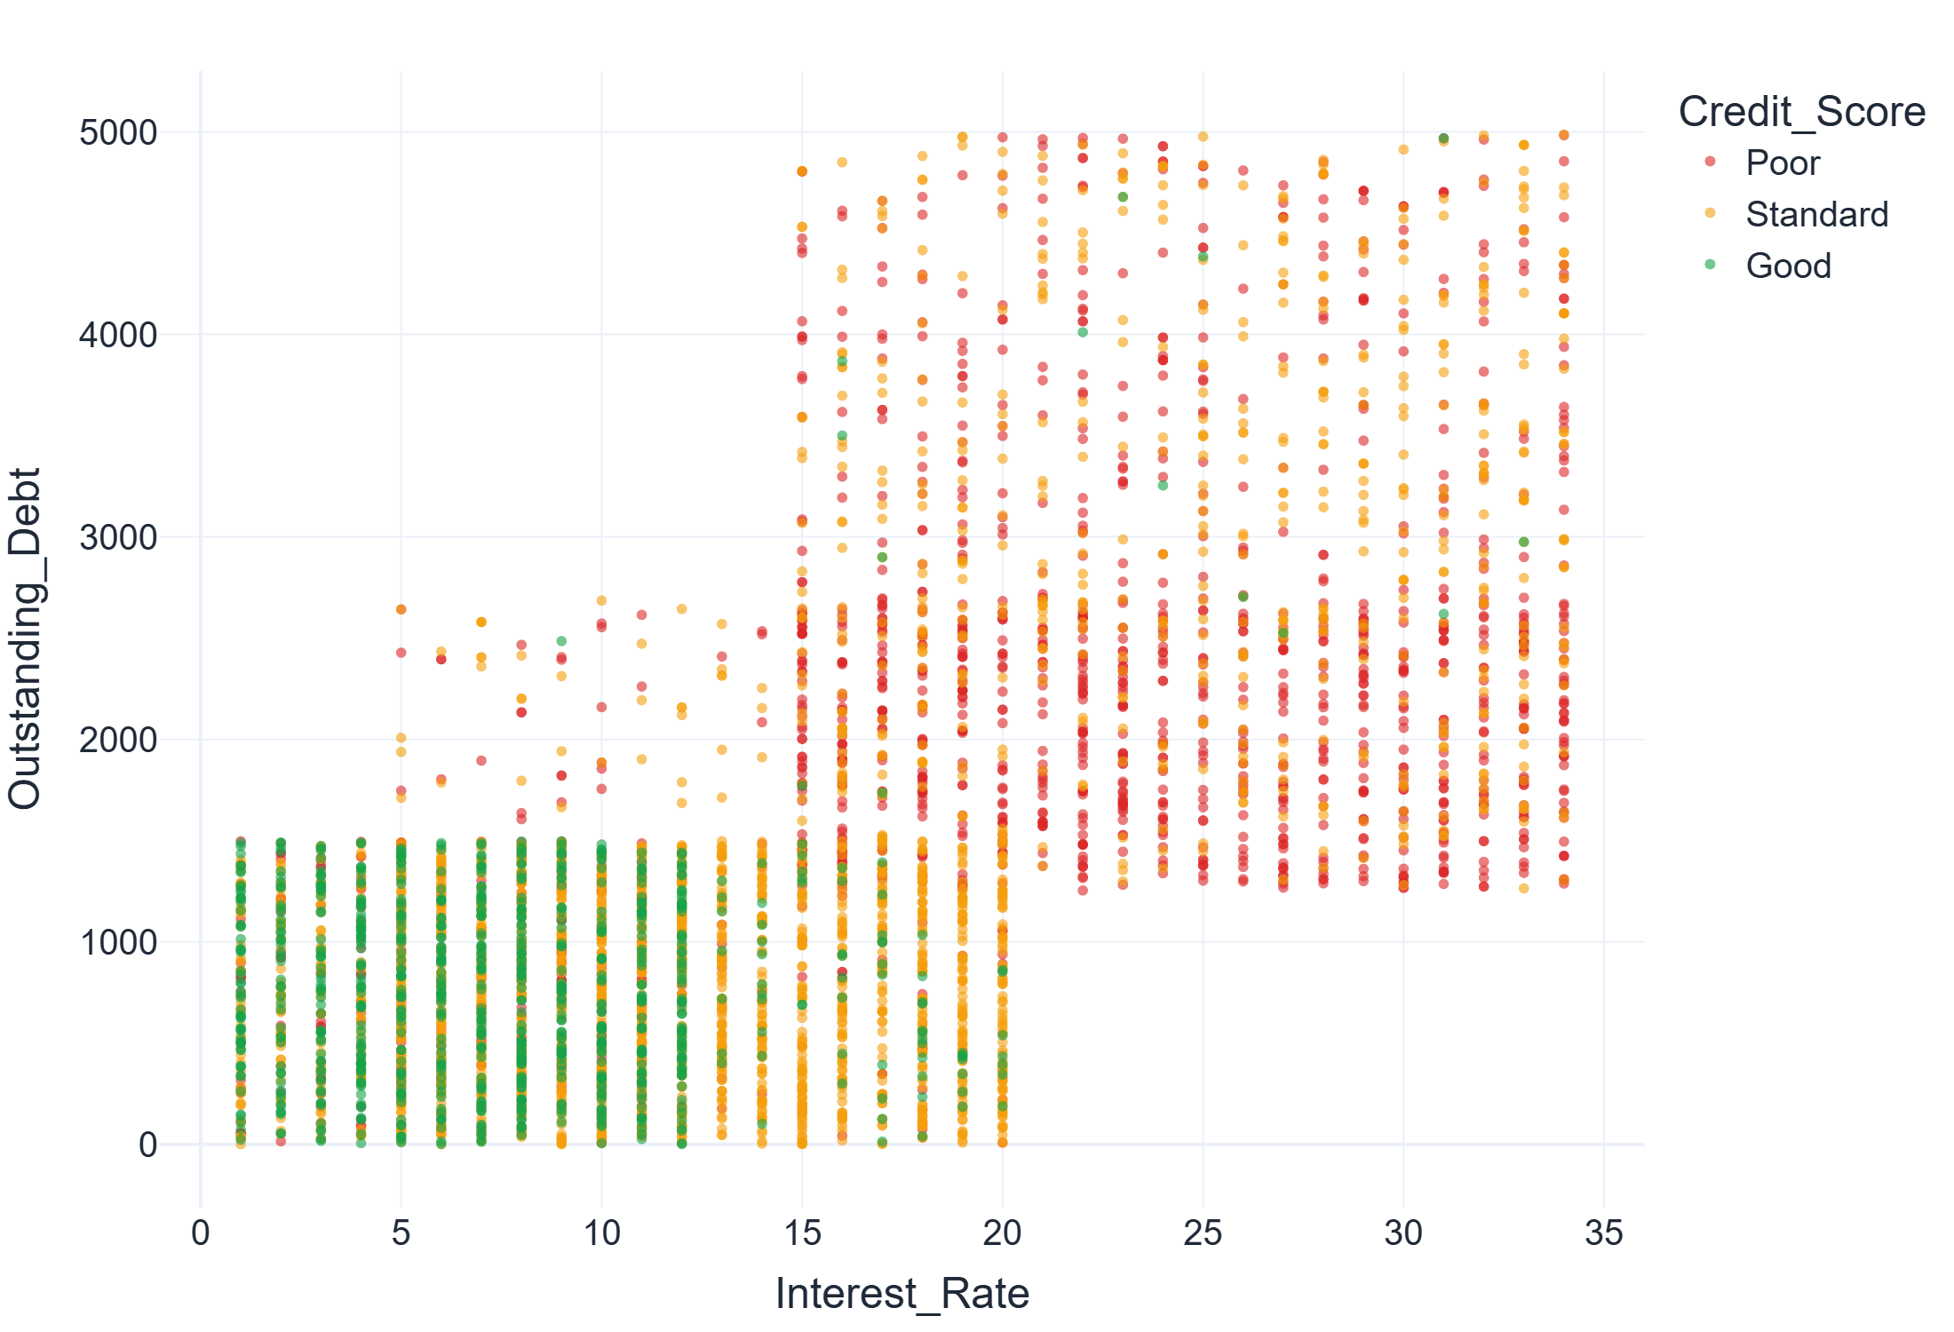
Poor scores carry more debt at higher rates
QUESTION 4 · HOW DO OUTSTANDING DEBT AND INTEREST RATE DIFFER BETWEEN SCORE GROUPS?
Answer
Median debt: $1,945 Poor vs $734 Good (≈ 2.6×). Median interest rate: 21% vs 7%.
Good scores cluster in the low-debt, low-interest corner. Credit utilization (~32%) is the same for every group.
Notes:
Poor customers owe about 2.6 times more and pay three times the interest rate. In the scatter plot, Good scores cluster at low debt and low interest. Credit utilization, surprisingly, is the same for every group.

Slide 17
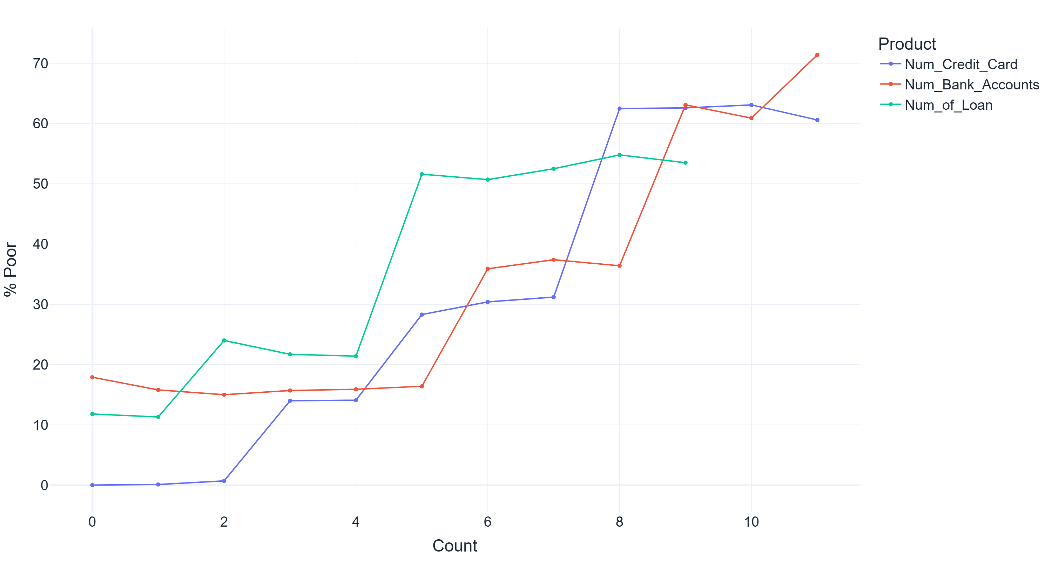
More cards, accounts and loans mean more risk
QUESTION 5 · DOES HAVING MORE CREDIT CARDS, BANK ACCOUNTS OR LOANS WORSEN THE SCORE?
0.4%
Poor with 0–2 credit cards
62.7%
Poor with 8+ credit cards
52.2%
Poor with 5+ loans
% of Poor credit scores by number of credit products
Notes:
The share of Poor scores climbs in steps as customers hold more credit cards, bank accounts and loans. With two cards or fewer, almost nobody is Poor; with eight or more, nearly two thirds are.

Slide 18
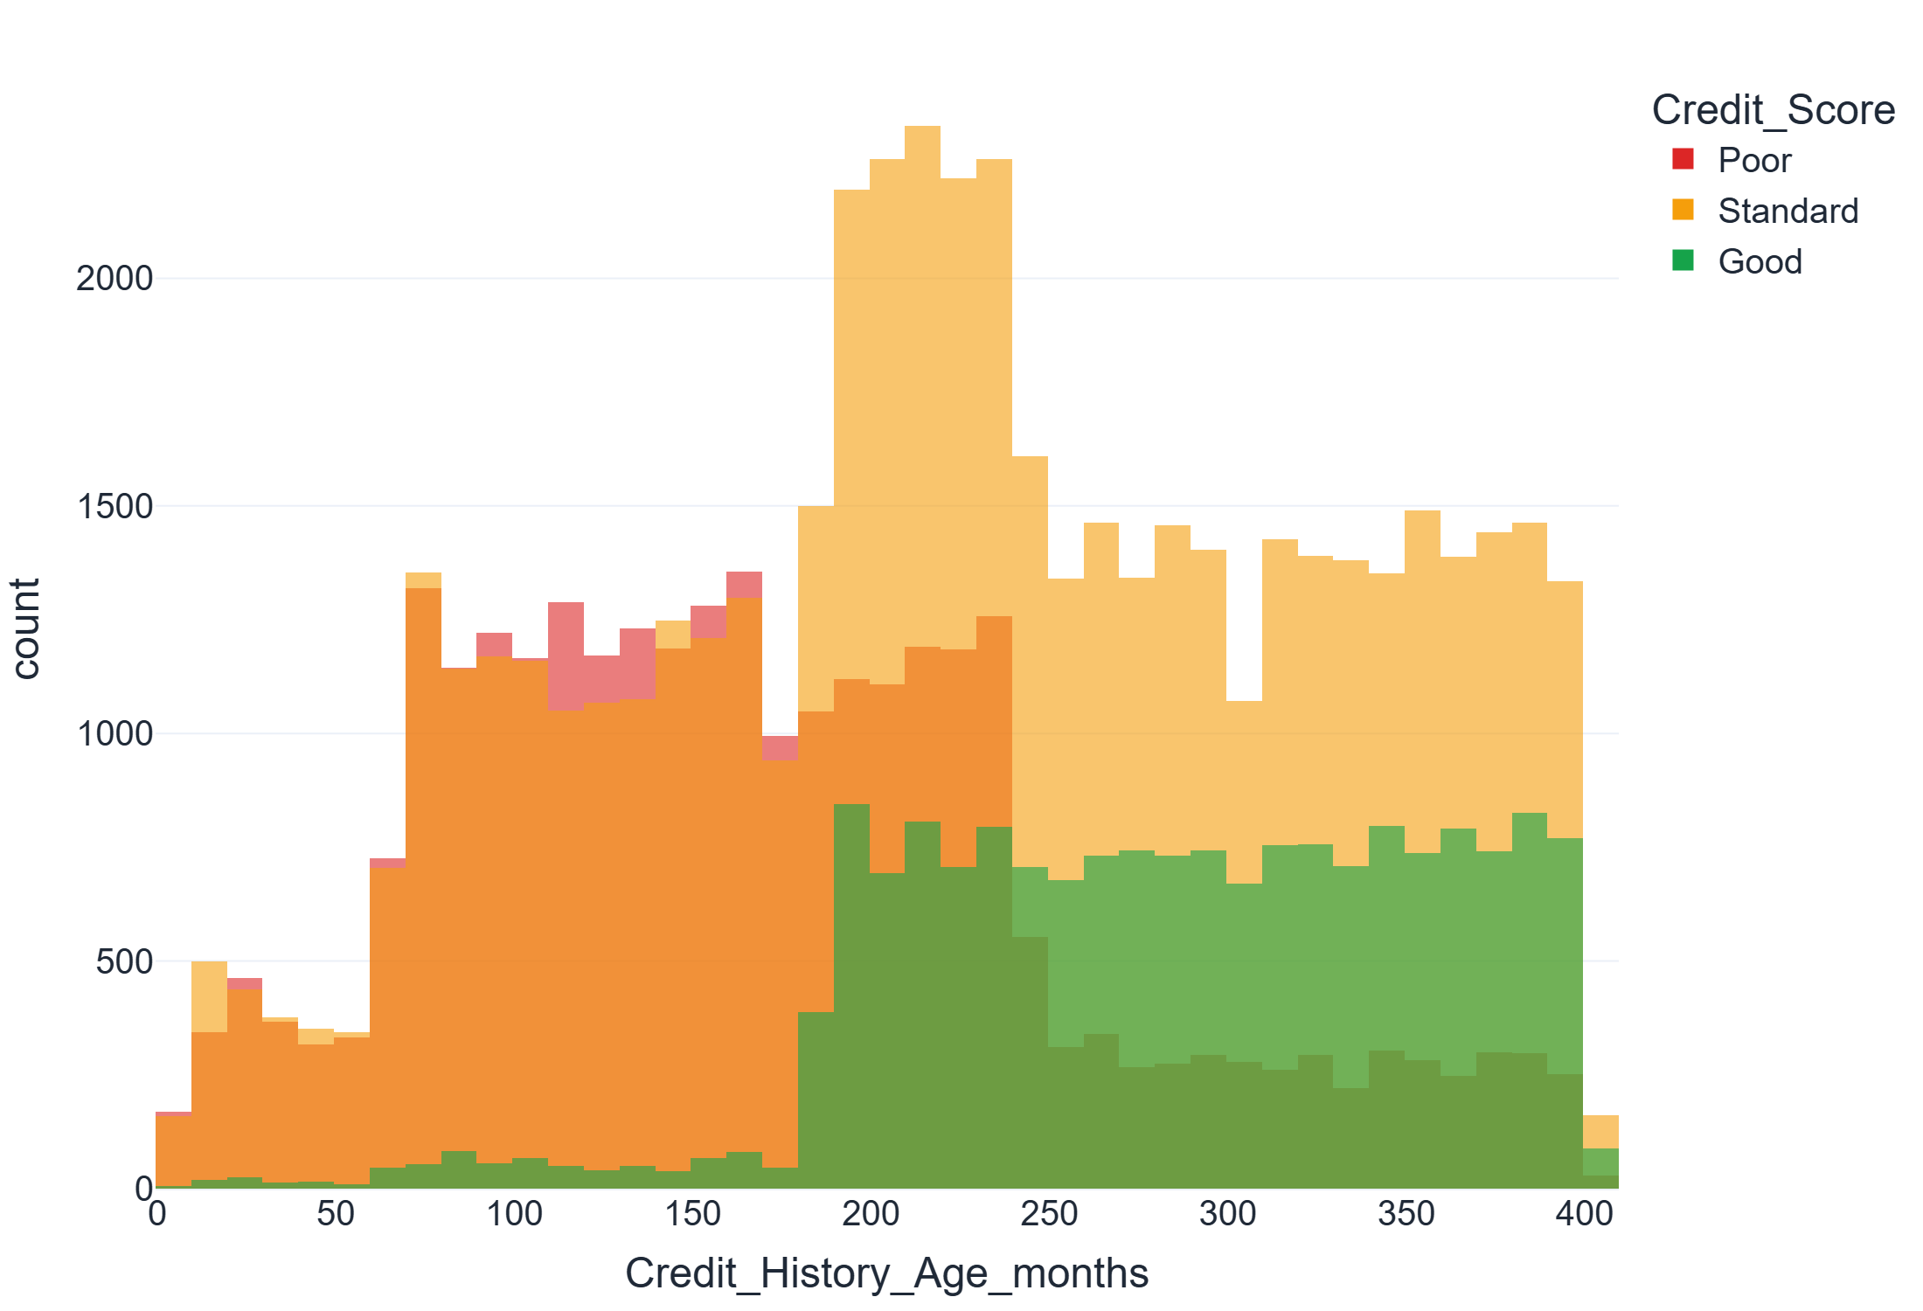
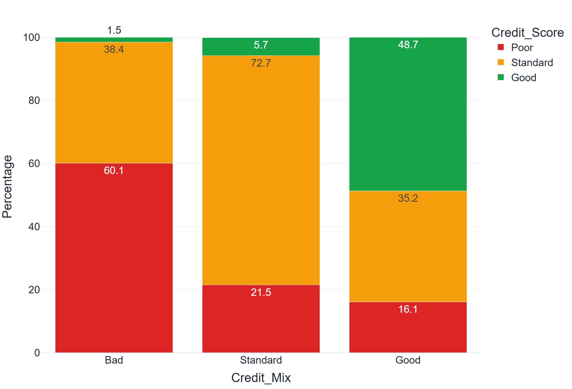
Long history and good credit mix mean Good
QUESTION 6 · DO A LONGER CREDIT HISTORY AND A BETTER CREDIT MIX MEAN A BETTER SCORE?
Answer
Median credit history: 13 years Poor · 19 years Standard · 24 years Good.
Bad credit mix: 60.1% Poor, 1.5% Good — Good credit mix: 48.7% Good. The biggest gap of any category.
Notes:
Customers with longer credit histories score better, and credit mix shows the largest difference of all categorical columns: a Bad mix is sixty percent Poor, a Good mix is almost half Good.

Slide 19
Behaviour matters far more than who you are
CONCLUSIONS
Strongest signals: credit mix, minimum-only payments, days late, debt, interest rate, number of credit products.
Helps: higher income and a longer credit history.
Weak: occupation (26–31% Poor in every job).
Recommendation: assess customers on how they use credit, not on demographics.
Notes:
Bringing it together: the share of Poor scores ranges from almost zero to over sixty percent depending on credit behaviour, while occupation barely matters. The recommendation is to focus on how customers use credit.

Slide 20
How the project meets each criterion
PROJECT CRITERIA
Criterion | Evidence in this project
Code functionality | Notebook runs top to bottom with no errors; reusable functions (impute_by_customer, fix_customer_spikes, plot helpers); commented code
Quality of analysis | Six questions stated up front and each answered with numbers
Data cleaning | Every change documented: type fixes, per-customer filling, outliers, dropped columns, engineered column
Exploration | 7 numeric + 4 categorical columns explored univariately, and against the credit score bivariately
Visual variety | Pie, histogram, box, bar, stacked bar, scatter, line and heatmap — 8 kinds of plots
Visualization | Consistent score colours (red / amber / green), labelled axes, sorted categories
Notes:
This slide maps each grading criterion to where the project covers it.

Slide 21
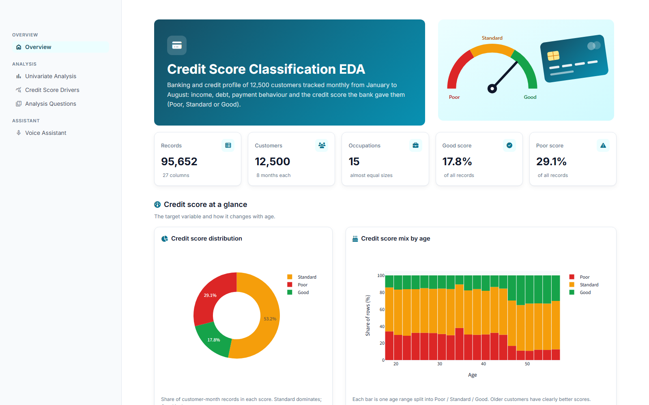
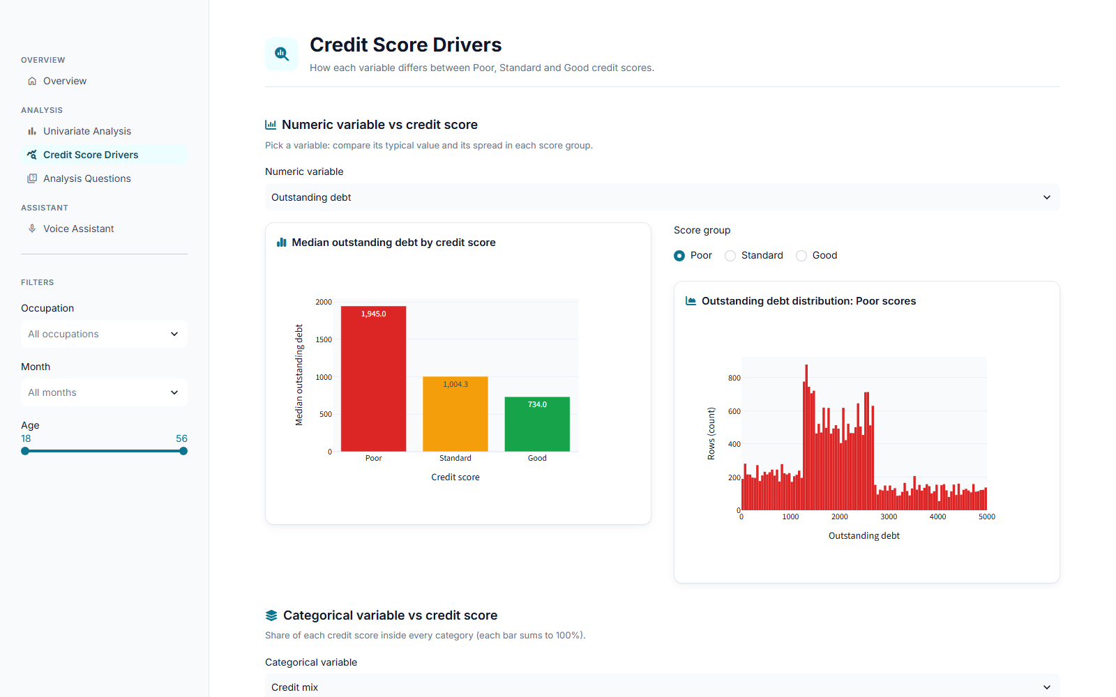



The analysis as an interactive app
STREAMLIT DASHBOARD
Filters
4 analysis pages
Voice assistant
Occupation, month and age on every analysis page
Overview, univariate, score drivers, the 6 questions
Gemini Live answers in Arabic and draws KPIs and charts
Notes:
The results are also available as a Streamlit dashboard with filters, four analysis pages and a voice assistant that answers questions in Egyptian Arabic and shows the relevant KPIs and charts.

Slide 22
Next: predict the score
Use the cleaned train.csv to train a classifier, then predict September – December scores for test.csv. Thank you!
Notes:
The natural next step is the machine-learning phase this dataset was built for: train a model on the cleaned training data and predict the scores in test.csv. Thank you — happy to take questions.

